Slide 1
June 2026
DEFECT GENERATION WITH STABLE DIFFUSION
Minh Le

Slide 2
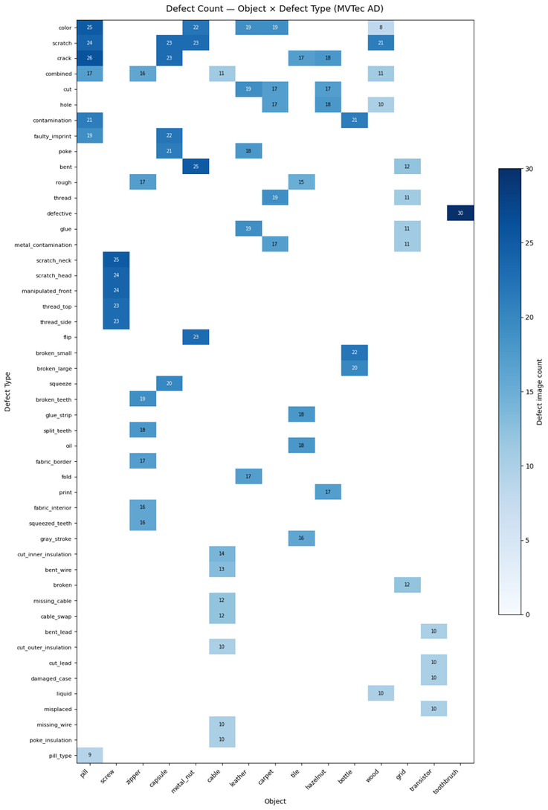
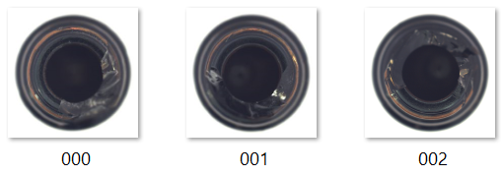
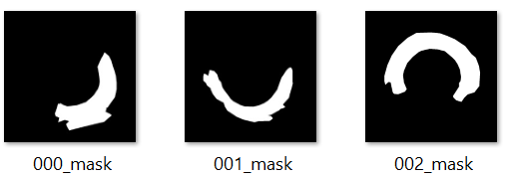
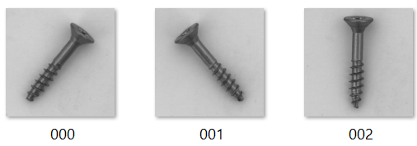
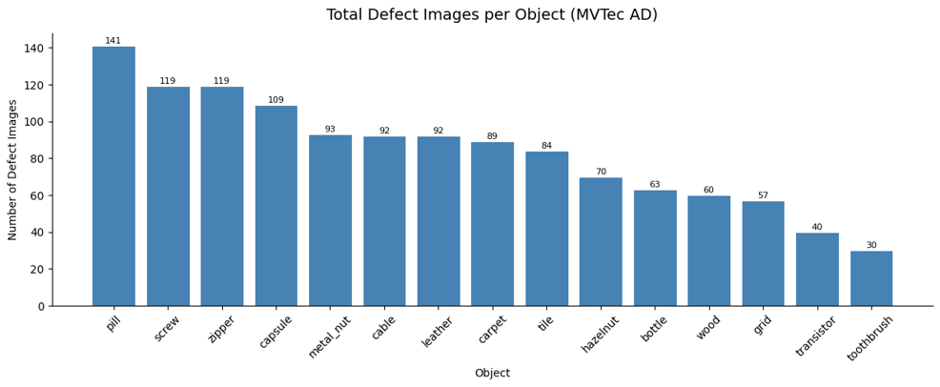
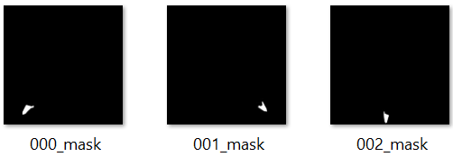
DATASET: MVTEC DATA
> 5000 images
High resolution (700x700 to 1024x1024)
70 different defects
~1260 images contain defects (1/4 of the dataset)
Great defects imbalance among objects

Slide 3
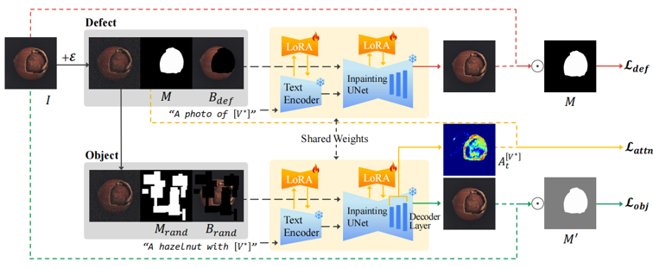
DEFECT FILL
Authors use a weighted loss:
Defect loss: Understanding of the defect itself
Object loss: Object-defect relationship
Attention loss: Spatial guidance
Ref: https://arxiv.org/abs/2503.13985

Slide 4
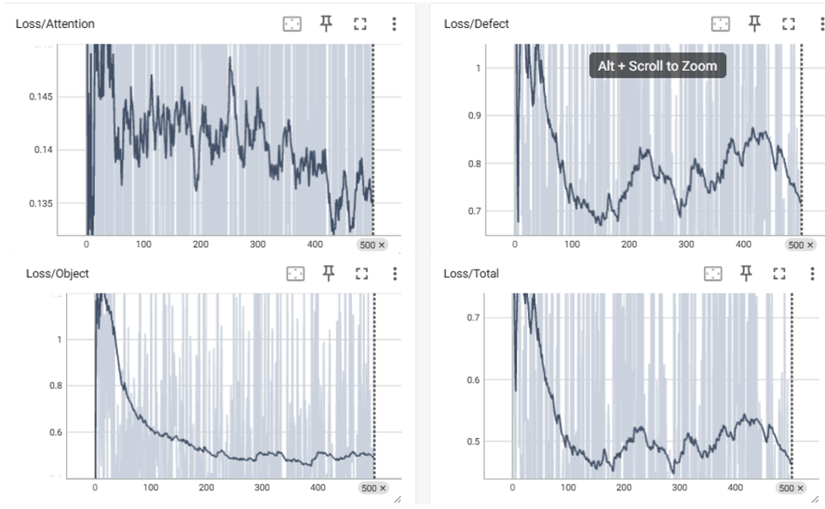
TRAINING PERFORMANCE
General decline across all 4 losses
Attetion loss oscillates with minor decline
⟶ Small contribution to the total loss
Total loss is dominated by object and defect loss
Defect loss decrease steadily and bounced back after 150 epochs
⟶ The model does not fully converge after 500 steps
Figure. Training loss for ‘bottle’ class
Notes:
- Raw loss is noise (small batch size due to limited GPU resource and sampling step) (authors has a batch size of 4)
- Smooth versions overall, shows a decline
- Total loss is dominated by object & defect loss (local peaks at step 250 & 450 is reflected on the total loss)
- Defect loss decrease steadily but increase after 150 steps -> does not fully converge after 150 steps (authors ran for 2000 steps) OR the minima has been missed

Slide 5
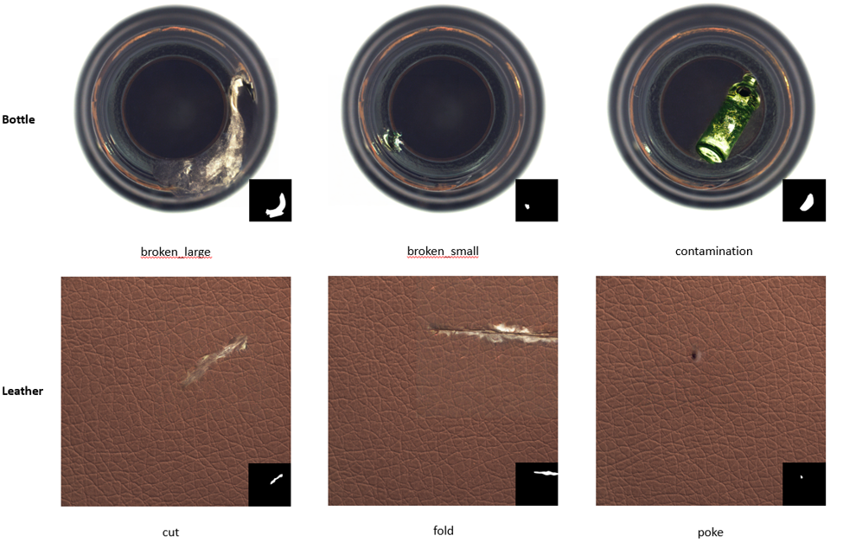
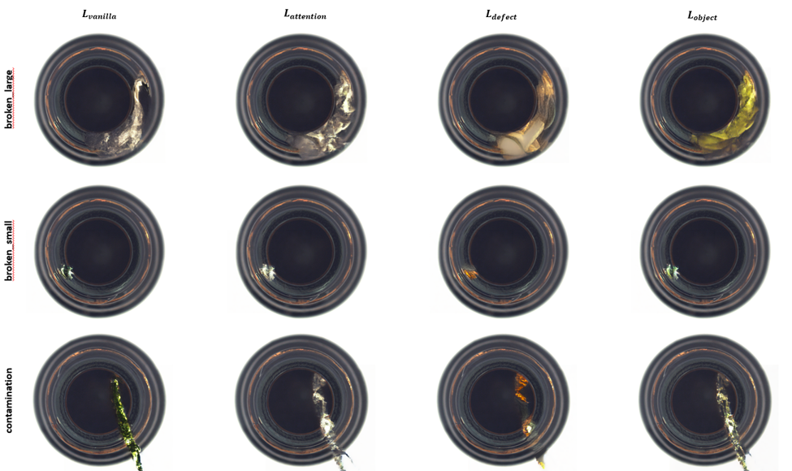
QUALITATIVE RESULTS
Figure. Ablation study: sample generations from 4 different bottle models, each with a type of loss ablated.
Figure. Qualitative results for bottle and leather defects generation
Notes:
BOTTLE
-broken_large looks the most convincing. Reflective glass texture blends naturally with the bottle interior.
- broken_small presents a small chip near the edge, but the green color makes it less realistic generation
- contamination is least realistic:
+ There are many types of contaminations within a defect type -> The model is trained on an inconsistent mix and never converge to a coherent concept.
LEATHER
- poke is the best result: dark, small dot with gradient color at its orifice
- Fold also shows an exposed material underneath, would have been a better generation for cut
+ Possible reason, same mask shape for both categories -> mix between cut & fold

Slide 6
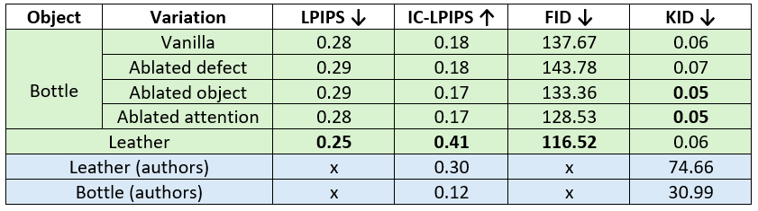
QUANTITATIVE RESULTS
Leather has the best performance, regarding diversity (IC-LPIPS) and realism (LPIPS & FID)
All 4 variations for bottle peform nearly identically
⟶ Ablation has no measurable impact in this setting
⟶ Ablated attention has the lowest FID, attention loss may not be useful at this scale
Based on the numerical metrics, my implementation outperforms author’s. That’s definitely not true in practice, due to:
Lack of an official implementation for DefectFill ⟶ Different evaluation settings, model architecture
Table. Benchmark evaluation

